Slide 1

INSTITUTE : UIE
DEPARTMENT : CSE
Bachelor of Engineering (Computer Science & Engineering)
WEB AND MOBILE SECURITY (Professional Elective-I)
(20CST/IT-333)
TOPIC OF PRESENTATION:
IOS, Android and Window phone Security Model
.
DISCOVER . LEARN . EMPOWER

Slide 2
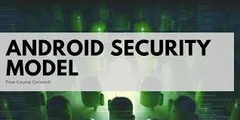
Lecture Objectives
In this lecture, we will discuss:
IOS, Android and Window phone Security Model

Slide 3
Introduction
Android software contains an open-source Linux Kernel having collection of number of C/C++ libraries which are exposed through an application framework services.
Among all the components Linux Kernel provides main functionality of operating system functions to smartphones and Dalvik Virtual Machine (DVM) provide platform for running an android application.
The main components of android architecture are following:-
Applications
Application Framework
Android Runtime
Platform Libraries
Linux Kernel

Slide 4
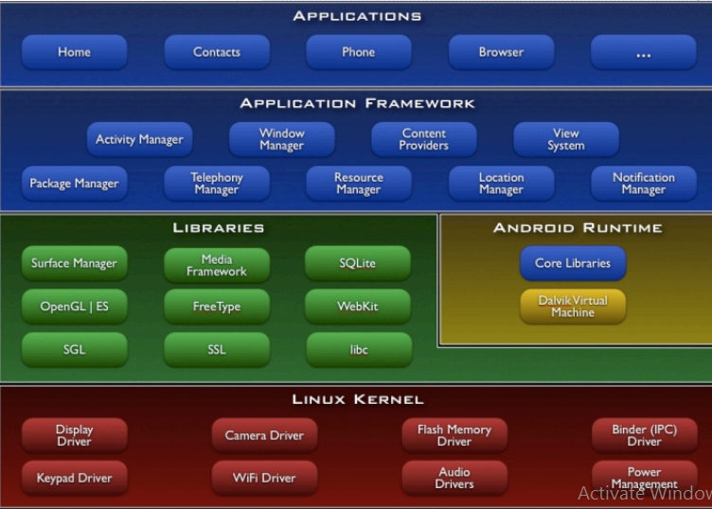

Slide 5
Types of attacks: Android
Untrusted APK’s: Attackers lure users to download applications from untrusted sources. These APK’s may contain malicious software inside them, giving the attacker remote access to the mobile device when the APK is installed by the user.
SMS: The user may come across a suspicious SMS giving them big bounty’s. When the users click that particular link in the message, they may be redirected to a malicious website giving away their sensitive information or may lead to financial loss.
Email: Phishing emails may redirect the users to malicious websites compromising the user’s details. SPAM emails may steal information from the users.
Spying: Some applications may spy on the mobile users and report to the remote attackers.
App sandboxing issues: Sandboxing is the process of testing an App in a limited resource environment against various threats and attacks. If sandboxing has issues, it means that malicious applications can bypass this mechanism.
Rooting: Rooting is done for increasing speed and performance of an android device. This is not a recommended solution by the android authorities. When a phone is rooted, it loses its warranty and may open the door for various malware and allows the attacker to take control of the device remotely.

Slide 6
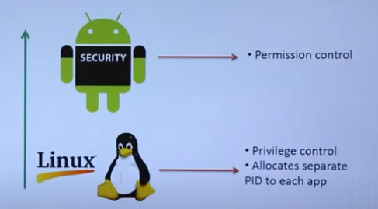
Android security Model

Slide 7
The Layers of the Android Security Model
The security model is based on the consent of the following parties:
1. Operating System
2. Application
3. End-User

Slide 8
1. Operating System
The kernel security determines the overall security of the whole system. The security of the Android operating system is based around the following key security features of the Linux kernel:
Process Isolation(sandboxing)
User-Based Permission Model
Inter-Process Communication (IPC)

Slide 9
The secure communication between applications is ensured by the Linux user-based protection.
Android platform uses the Linux user-based permissions model to isolate application resources. This process in called application sandbox.
The aim of sandboxing is to prevent malicious external programs from interacting with the protected app.
The internal operating system components are also protected by the sandboxing mechanism.
Unlike traditional operating systems, e.g. MacOS and Windows, Android uses the User ID (UID) concept to manage an application’s access control and not the system user’s access control.
An application is prohibited from accessing other application’s data or system features without the necessary permissions.
The application is sandboxed at the kernel level, hence it is guaranteed that the application is isolated from the rest of the system, regardless of specific development environment, programming languages or APIs used.

Slide 10
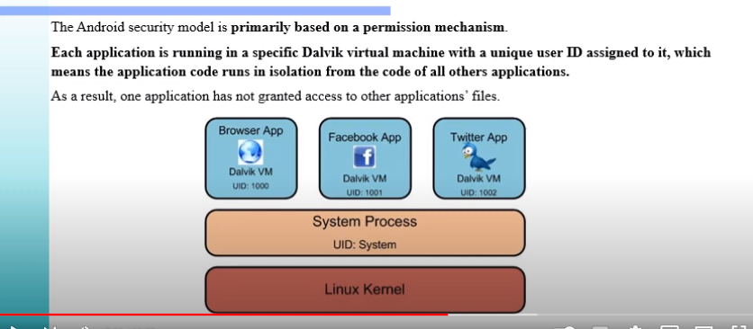

Slide 11
Rooting
On a Linux system, root is the name of the account that has access to all files and commands. Rooting is the process of gaining access to more administrative-level controls on an Android device. Despite its benefits, attackers often use rooting to target sensitive user and business data.
Owner of the device is NOT root. Android is designed to be open. Consequently, the user is allowed to root the phone, i.e. switch to the root user.
It should be noted that rooting is not recommended to be done by inexperienced users. Rooting a phone might result in making the warranty null.
Without rooting, users cannot access or modify system files and folders.
Once rooted, the user has full access to the device. Rooting allows the user to make changes to everything on the device. This allows users to do things that were previously impossible, like removing bloatware, customization, custom ROMs, etc.

Slide 12
Rooted devices may contain many apps that process sensitive information, such as banking apps, payment apps, social media, and cloud storage.
Malicious downloads can expose your device to hackers.
Verified Boot is a process that ensures that the device is booting the original operating system alongside the afferent system code, and not a malicious replica. It establishes a chain of trust between the multiple components that can be altered, starting from the hardware up to the verified partitions
https://www.appknox.com/blog/root-detection-techniques

Slide 13
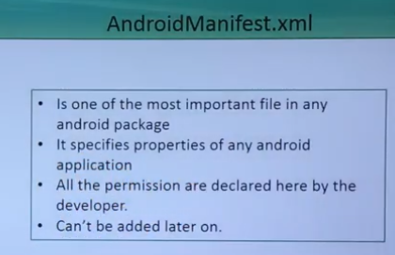
2. Application Security
Permissions
In Android, the user’s privacy is protected by the means of permissions. Android applications requires the user’s consent to perform actions. The manifest file describes essential information about your app to the Android build tools, the Android operating system, and Google Play.
The permissions required by an application are declared in the AndroidManifest.xml. Every permission is specified in its own uses-permission tag.

Slide 14
Application Signing
Application signing is the first step in the application sandbox mechanism.
An UID is assigned based on the certificate used to sign the application.
Code signing provides developers with the ability to identify the author of an application
Applications that are not signed by a developer cannot be uploaded to Google Play.
Even if an unsigned application package ended up on the device, the application cannot be installed because the package manager checks whether the package is signed or not before installing any application.

Slide 15
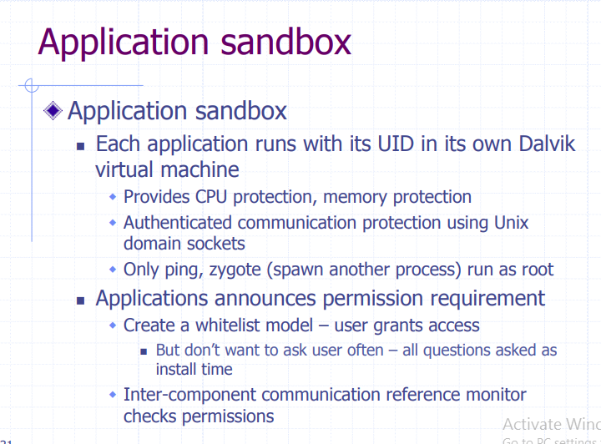

Slide 16
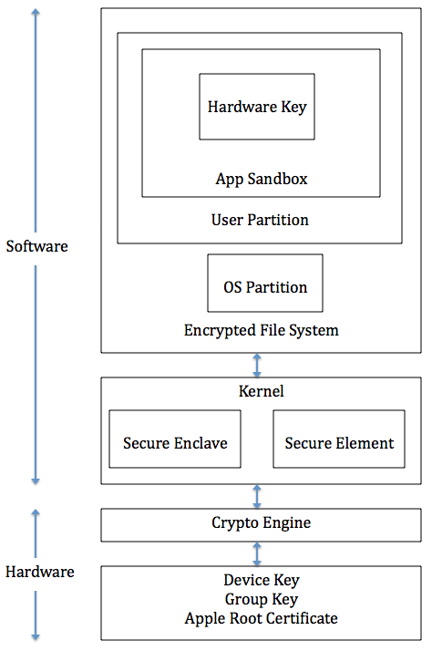
IOS Security Model
Is iOS closed or open source?
Apple's iPhone/iOS platform is generally classified as a closed ecosystem because Apple has complete control over both the software (the operating system and apps that can be installed) and the hardware (the phone itself).
Both the Mac OS X and iOS evolved from an earlier Apple operating system, Darwin, based on BSD UNIX. iOS is a proprietary mobile operating system owned by Apple and it is only allowed to be installed in Apple equipment.

Slide 17
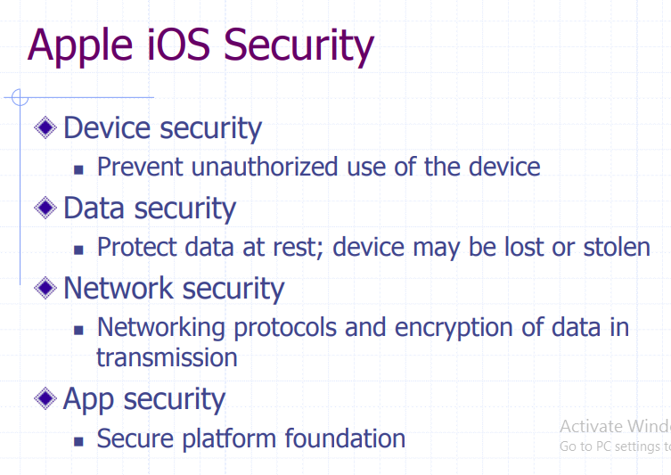
https://crypto.stanford.edu/cs155old/cs155-spring14/lectures/17-mobile-platforms.pdf

Slide 18
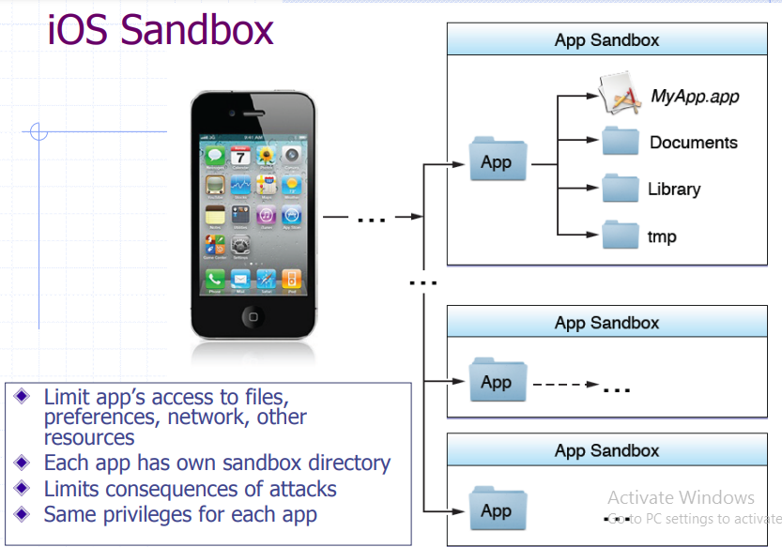

Slide 19
Secure booting process
During the booting process, iOS uses a mechanism called "secure boot chain" to ensure that the low-level software is not compromised and iOS is running on a validated iOS device. Each step in secure boot chain verifies if the next step of chain is valid and signed by Apple. The booting process will only proceed to the next step of chain if the verification succeeds.
When you turn on an iOS device, the processor first executes the code from Boot ROM.
The code in Boot ROM is created during chip fabrication, hence it is trusted and immutable. The code in Boot ROM also contains the Apple Root CA public key, which will be used to verify if Low-Level Bootloader (LLB) is signed by Apple.
If LLB is valid, the processor will run the next-stage bootloader, iBoot, which will in turn verify and run the iOS kernel.

Slide 20
Secure Enclave
The Secure Enclave is a coprocessor for Apple’s A-series processor. It has its own secure boot separated from the application processor, communication between it and the application processor is highly encapsulated. Its tasks include key management, processing cryptographic operations and maintaining the data integrity.
Each Secure Enclave comes with a unique ID (UID) during the fabrication. Other parts of the system don’t have access to UID, neither does Apple. UID is used to encrypt the Secure Enclave’s memory space and data of files stored in the file system.
The Secure Enclave is also responsible for decrypting and processing the fingerprints received from the Touch ID, verifying if the coming fingerprints match the registered fingerprints. The application processor forwards the fingerprints data to the Secure Enclave. Because the fingerprints data is encrypted with a session key between the Secure Enclave and the Touch ID, the application processor can’t read it.

Slide 21
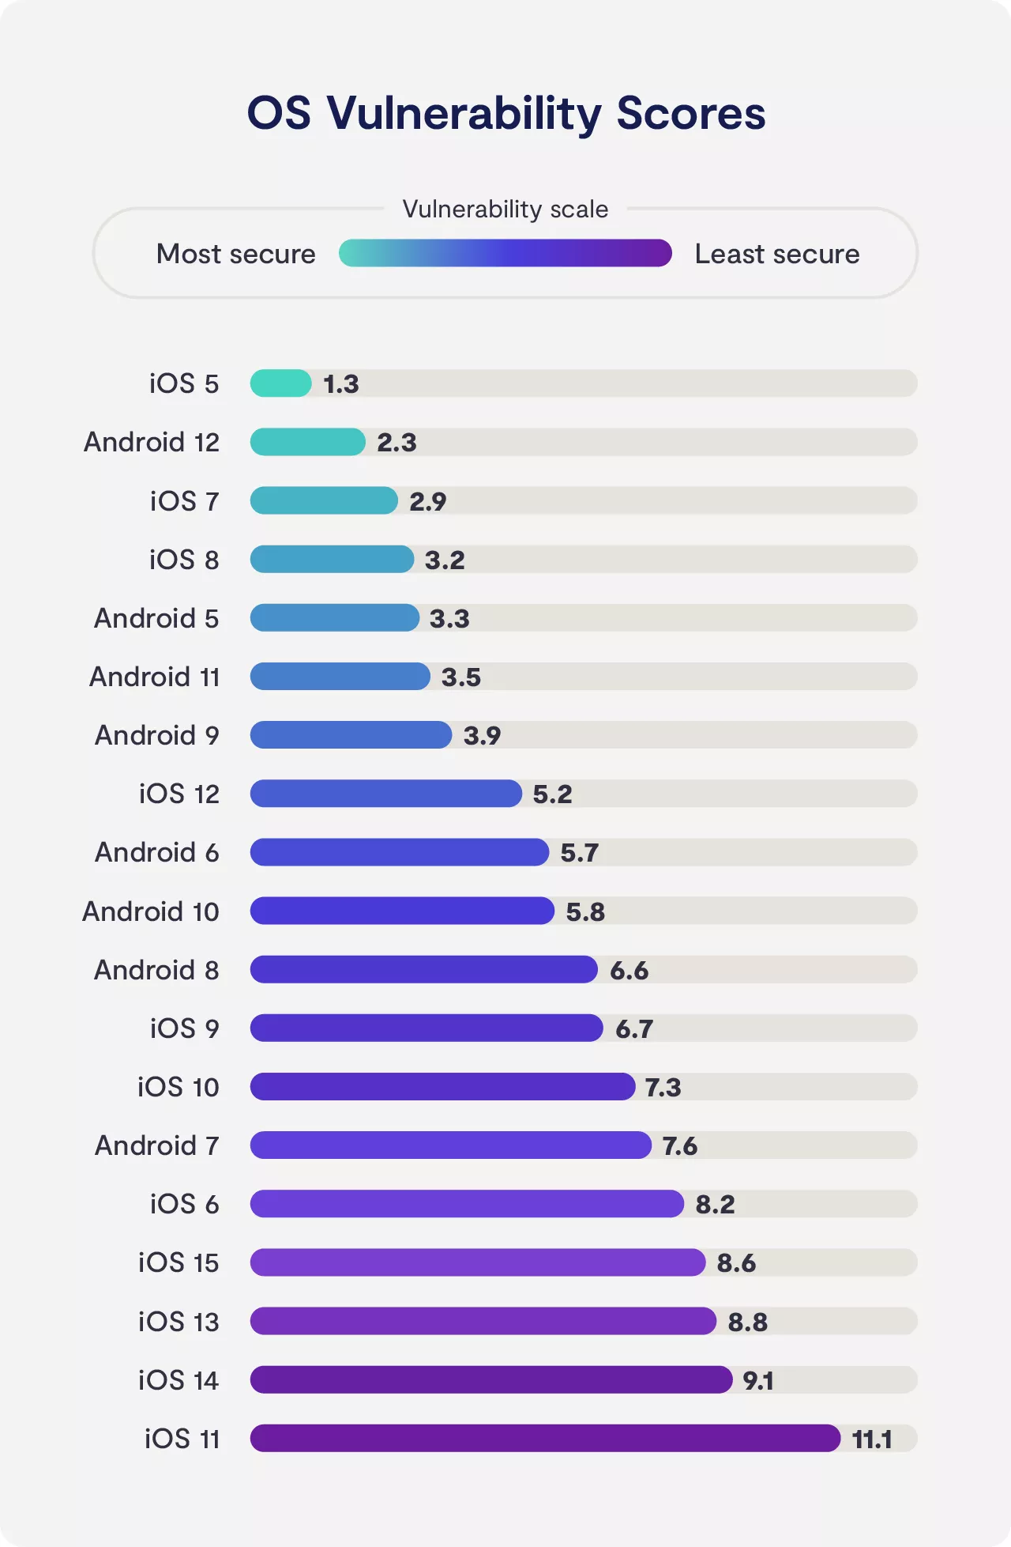
iOS 5 and 7 and Android 12 were the most secure while iOS 11, 13, and 14 were the least secure.

Slide 22
iOS vs. Android: Which is more secure in 2022?
most secure operating system is iOS
Ultimately, what gave iOS the win was its ability to deliver frequent updates to almost all of its recent devices. While Android has had secure updates over the years, its ability to deliver those updates quickly is limited
Whether you own an Android or an iPhone, however, you can never be 100% safe from security breaches and zero-day attacks.
Make sure that you’re always proactive about using security solutions such as VPNs and spyware removal tools.
https://clario.co/blog/ios-vs-android-security/

Slide 23
What do iOS and Android security have in common?
Both iOS and Android have similar built-in features, including virtual sandboxes that limit the damage that malware apps can do. iOS drive encryption comes standard while Android users must enable this feature.
Both OS fully support VPN encryption, which is especially important for mobile devices (NordVPN provides top-of-the-line security to both iOS and Android devices.

Slide 24
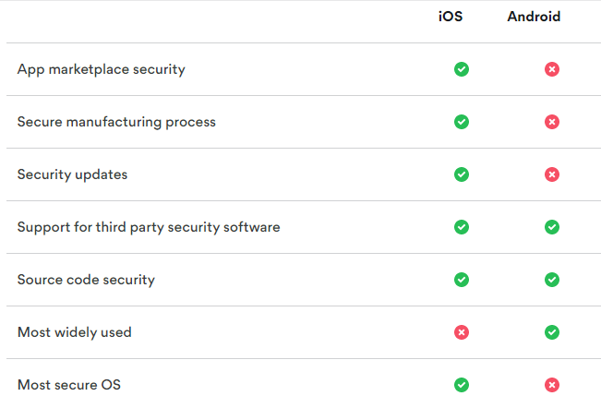

Slide 25
Windows Phone security
Windows mobile OS is similar to iOS in that a human reviews and approves all apps submitted to the store, helping prevent malicious applications gaining access to the Windows Store. Unlike Android, there’s no need to consider dedicated anti-virus and anti-malware software.
currently Windows is the least utilized mobile OS of the three, which definitely plays in its favor as it is less of a target.
Microsoft’s Windows Phone platform is the safest mobile operating system available to businesses while Android remains a haven for cyber criminals.

Slide 26
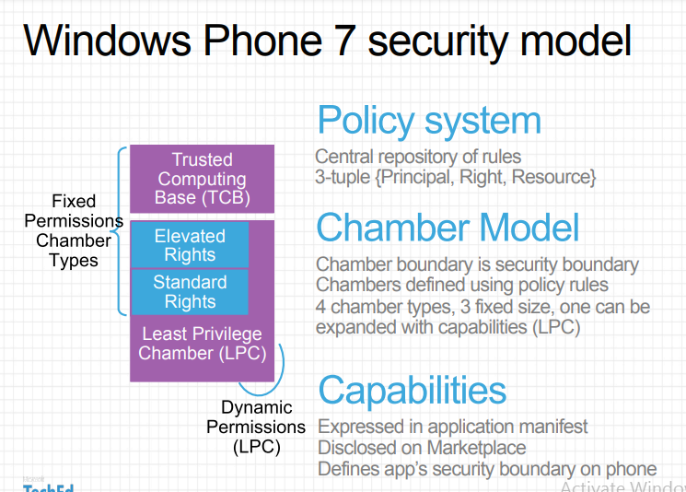

Slide 27
When it comes to security on Windows mobile devices, there are two important principles at work:
the idea of least privilege and
the concept of isolation.
Least privilege means that rights and permissions for users or developers are restricted to only the minimum necessary to complete the task. In short, rather than having free rein of all of a Windows Phone's processes, an app developer will only have access to those areas required to reasonably perform a task.
Isolation is the notion that phone elements and processes have boundaries within which they must operate, without infringing into the boundary of any other element or process.
To construct this type of security model, Windows Phone developers turned to the idea of security chambers.

Slide 28
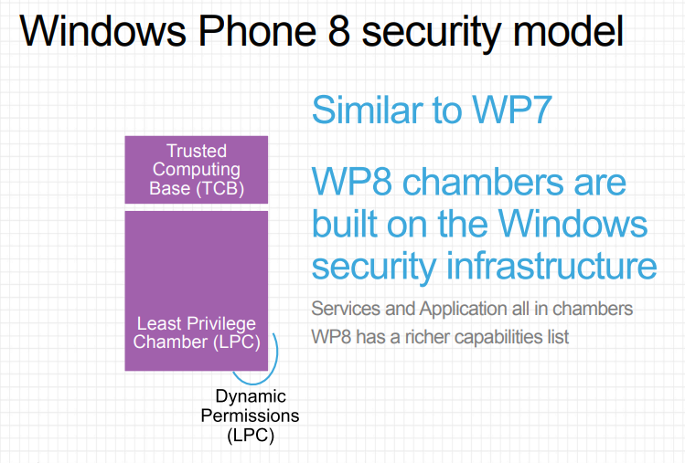

Slide 29
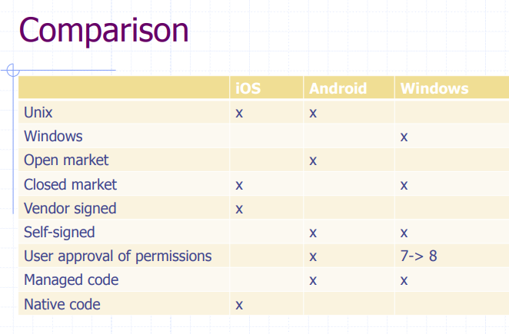

Slide 30
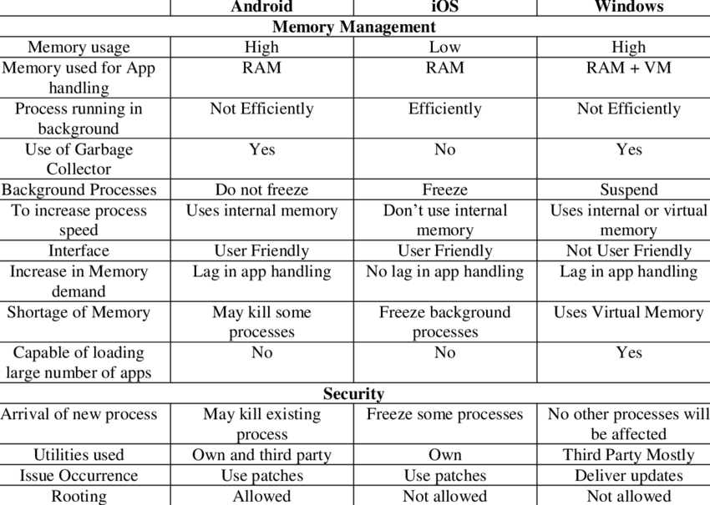

Slide 31
Countermeasures:
Do not root your phone.
Do not download applications from untrusted third party sources.
Do not click on suspicious emails.
Do not open suspicious SMS.
Use strong passwords/patterns.
Use Device administration API to set up password policy, remote wipe, etc.
Do not store passwords on phone.
Update the operating system regularly.
Use strong anti-virus.

Slide 32
References:
Books:
Hacking Exposed Mobile: Security Secrets & Solutions 1st Edition, Kindle Edition, by Neil Bergman, Mike Stanfield, Jason Rouse, and Joel Scambray
Hacking Exposed Web Applications, 3rd edition, Joel Scambray, Vincent Liu, Caleb Sima, Released October 2010, Publisher(s): McGraw-Hill
Video Lectures :
1. https://www.kaspersky.com/resource-center/threats/android-vs-iphone-mobile-security
2. https://www.diffen.com/difference/Android_vs_iOS
Reference Links:
1. https://www.tutorialspoint.com/mobile_security/mobile_security_windows_phone_os.htm
2. https://logrhythm.com/solutions/security/zero-trust-security-model/
3. https://crypto.stanford.edu/cs155old/cs155-spring14/lectures/17-mobile-platforms.pdf

Slide 33
THANK YOU

